Slide 1


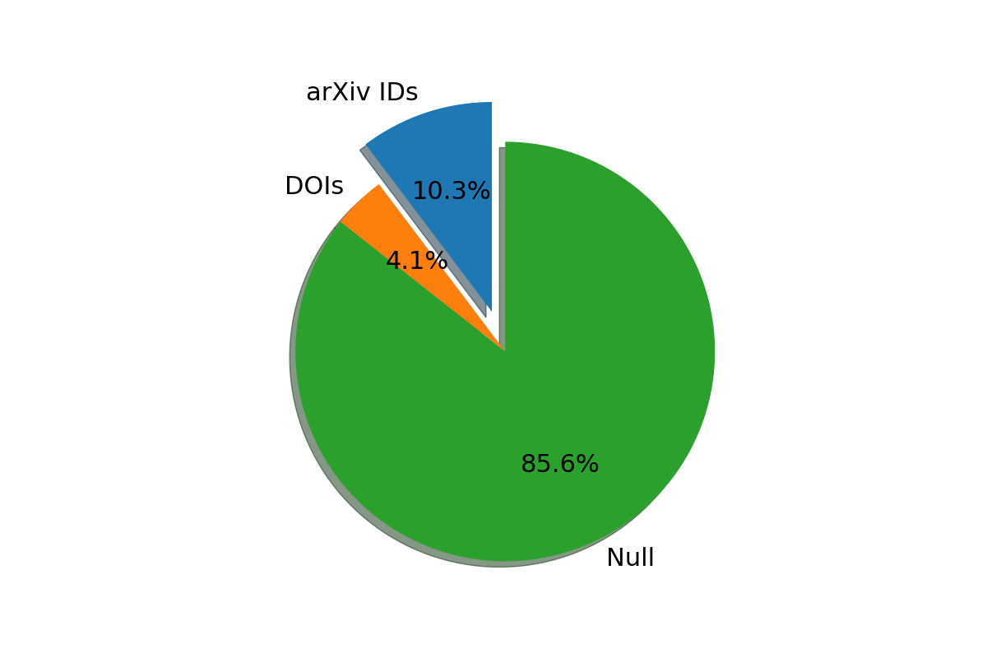
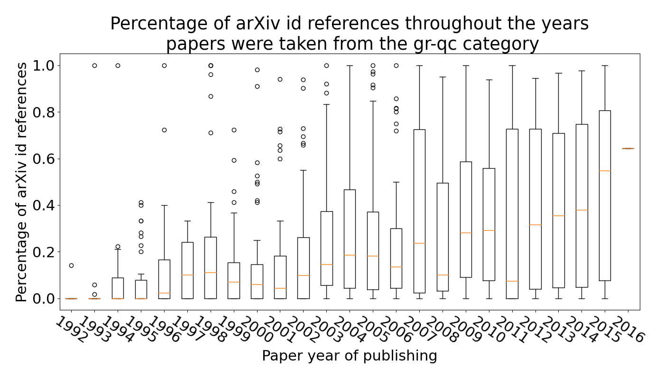
Extracting Reference Metadata from arXiv Papers
Matej Vedak
Supervisor: Doctor Florian Beutler
Introduction
ArXiv is a free paper distribution service and an open-access archive for scholarly articles in various quantitative fields (physics, mathematics, et cetera).
The goal of this project was to create a python script that can extract references from a pure TeX file (or BibTeX), and extract metadata for every found reference. This seemingly innocent task turned out to be quite hard – primarily because of vastly different standards in writing scientific refernces.
The primary focus was on references that reference other arXiv papers, but the script was designed with all references in mind.
The end goal of this project was to have a script that can be easily implemented on the Benty-Fields website [1].
Results
We sampled a set of 100 random arXiv papers to use for testing purposes. Surprisingly, only 14.4% of references contain etiher an arXiv ID or a DOI.
This small percentage can be explained by noting that our test set contained many old arXiv papers, papers released before 2005. Back then, referencing papers with arXiv IDs wasn’t popular so many references simply didn’t contain them (nor DOIs, another identifier that was popularized relatively recently). Analysing the arxiv ids percentage through the years a clear upward trend can be seen, and in the most recent years (2014, 2015, arxiv’s server refused to return data for later years) the median percentage of references with an arxiv id surpassed 50%.
Conclusions
This project’s main goal was achieved: an easily adaptable python script that can smoothly be deployed on a website. The script offers various user options, depending on the specific needs.
If only extracting metadata for references that contain identificators, the whole subset of 100 random papers is processed in 0.23 hours.
Extracting metadata for every single reference takes a bit longer, mostly because of the need for external resources such as Crossref. The test set can be processed in as little as 1 hour (depending on Crossref’s server load mostly).
These processing speeds are acceptable, as the goal was to be able to process 2000 papers a day, since around 2000 new papers are published on arXiv every day.
As with every project, there is always room for improvement. Here it comes in the form of Natural Language Processing. If executed correctly, it could eliminate some need for external resources and increase processing speed.
Figure 1: Distribution of comment codes.
Figure 1: Distribution of identifiers within the references of 100 arXiv test papers.
Methods
References to other arXiv papers were recognized through the usage of regular expression (regex), as were the DOIs. The main tool in extracting metadata was either arXiv’s XML API, or Crossref’s XML and JSON APIs. Extracted metadata is stored in a database – we utilized SQLite and its sqlite3 implementation in python.
References
[1] Florian Beutler and Morag Scrimgeour. Benty-Fields. 2015. url: https://bentyfields.com/ (visited on 07/14/2022).
Acknowledgements
Thanks to Doctor Florian Beutler, a great mentor and a pleasure to work with.
Figure 2: Candlestick chart of arXiv Ids percentage among all references. 50 papers per year were analyzed. The thin red line is the median, the box encloses 50% of all data and the whiskers 99%
Notes:
Copyright Colin Purrington (http://colinpurrington.com/tips/academic/posterdesign).

